Slide 1
Chapter 6 - Activity planning
SOFTWARE
PROJECT MANAGEMENT

Slide 2
Scheduling
‘Time is nature’s way of stopping everything happening at once’
Having
  worked out a method of doing the project
  identified the tasks to be carried
  assessed the time needed to do each task need to allocate dates/times for the start and end of each activity
Notes:
Topics covered
Professional software development
What is meant by software engineering.
Software engineering ethics
A brief introduction to ethical issues that affect software engineering.
Suggested student projects
A brief introduction to each suggested project that can be carried out by students for this course

Slide 3
Activity networks
These help us to:
  Assess the feasibility of the planned project completion date
  Identify when resources will need to be deployed to activities
  Calculate when costs will be incurred
This helps the co-ordination and motivation of the project team
Notes:
Topics covered
Professional software development
What is meant by software engineering.
Software engineering ethics
A brief introduction to ethical issues that affect software engineering.
Suggested student projects
A brief introduction to each suggested project that can be carried out by students for this course

Slide 4
Defining activities
Activity networks are based on some assumptions:
A project is:
  Composed of a number of activities
  May start when at least one of its activities is ready to start
  Completed when all its activities are completed
Notes:
Topics covered
Professional software development
What is meant by software engineering.
Software engineering ethics
A brief introduction to ethical issues that affect software engineering.
Suggested student projects
A brief introduction to each suggested project that can be carried out by students for this course

Slide 5
Defining activities
An activity
  Must have clearly defined start and end-points
  Must have resource requirements that can be forecast: these are assumed to be constant throughout the project
  Must have a duration that can be forecast
  May be dependent on other activities being completed first (precedence networks)
Notes:
Topics covered
Professional software development
What is meant by software engineering.
Software engineering ethics
A brief introduction to ethical issues that affect software engineering.
Suggested student projects
A brief introduction to each suggested project that can be carried out by students for this course

Slide 6
Identifying activities
Work-based: draw-up a Work Breakdown Structure listing the work items needed
Product-based approach
  list the deliverable and intermediate products of project – product breakdown structure (PBS)
  Identify the order in which products have to be created
  work out the activities needed to create the products
Notes:
Topics covered
Professional software development
What is meant by software engineering.
Software engineering ethics
A brief introduction to ethical issues that affect software engineering.
Suggested student projects
A brief introduction to each suggested project that can be carried out by students for this course

Slide 7
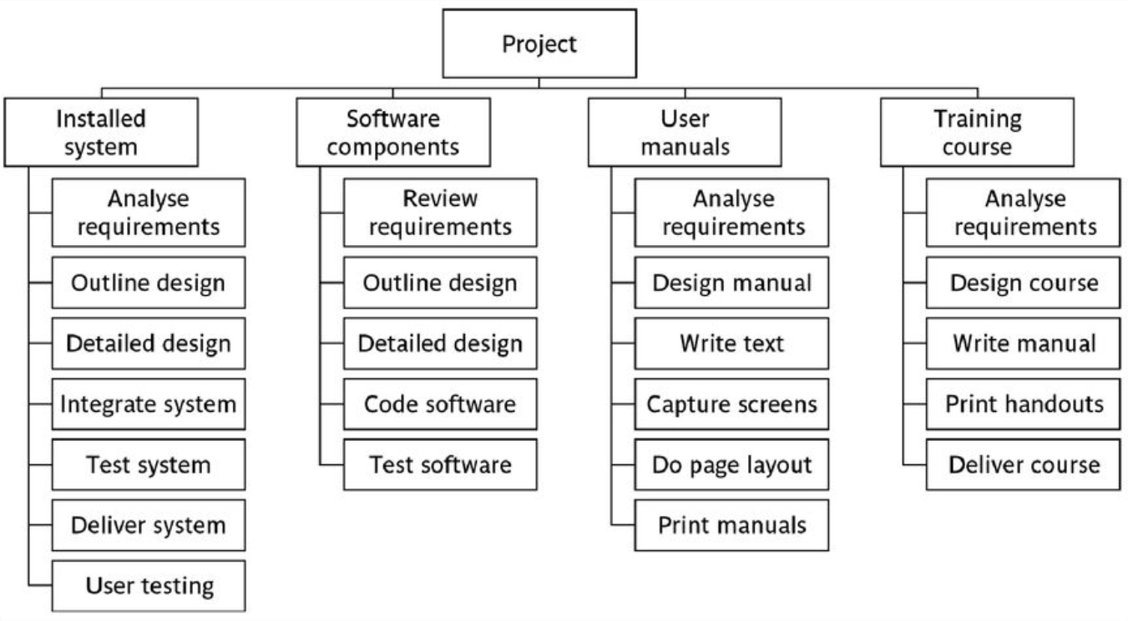
Hybrid approach
Notes:
Topics covered
Professional software development
What is meant by software engineering.
Software engineering ethics
A brief introduction to ethical issues that affect software engineering.
Suggested student projects
A brief introduction to each suggested project that can be carried out by students for this course

Slide 8
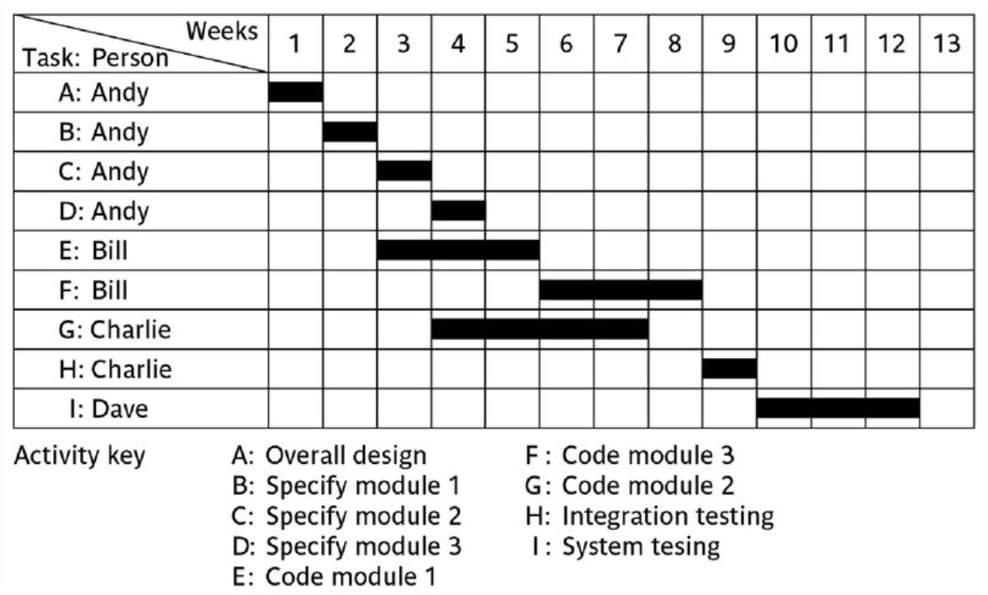
The final outcome of the planning process
A project plan as a bar chart
Notes:
Topics covered
Professional software development
What is meant by software engineering.
Software engineering ethics
A brief introduction to ethical issues that affect software engineering.
Suggested student projects
A brief introduction to each suggested project that can be carried out by students for this course

Slide 9
PERT vs cpm
PERT
Do B
Do A
Do D
Do C
CPM
Do B
Do A
Do D
Do C
Notes:
Topics covered
Professional software development
What is meant by software engineering.
Software engineering ethics
A brief introduction to ethical issues that affect software engineering.
Suggested student projects
A brief introduction to each suggested project that can be carried out by students for this course

Slide 10
Drawing up a PERT diagram
No looping back is allowed – deal with iterations by hiding them within single activities
milestones – ‘activities’, such as the start and end of the project, which indicate transition points. They have zero duration.
Notes:
Topics covered
Professional software development
What is meant by software engineering.
Software engineering ethics
A brief introduction to ethical issues that affect software engineering.
Suggested student projects
A brief introduction to each suggested project that can be carried out by students for this course

Slide 11
Lagged activities
where there is a fixed delay between activities e.g. seven days notice has to be given to users that a new release has been signed off and is to be installed
Acceptance
testing
7 days
Install new
release
20 days
1 day
Notes:
Topics covered
Professional software development
What is meant by software engineering.
Software engineering ethics
A brief introduction to ethical issues that affect software engineering.
Suggested student projects
A brief introduction to each suggested project that can be carried out by students for this course

Slide 12
Types of links between activities
Finish to start
Software
development
Acceptance testing
Start to start/ Finish to finish
Test prototype
Document
Amendments
2 days
1 day
Notes:
Topics covered
Professional software development
What is meant by software engineering.
Software engineering ethics
A brief introduction to ethical issues that affect software engineering.
Suggested student projects
A brief introduction to each suggested project that can be carried out by students for this course

Slide 13
Types of links between activities
Start to finish
Operate temporary
system
Acceptance test
of new system
Cutover to new
system
Notes:
Topics covered
Professional software development
What is meant by software engineering.
Software engineering ethics
A brief introduction to ethical issues that affect software engineering.
Suggested student projects
A brief introduction to each suggested project that can be carried out by students for this course

Slide 14
Start and finish times
Earliest start
Latest finish
activity
Latest start
Earliest finish
Activity ‘write report software’
Earliest start (ES)
Earliest finish (EF) = ES + duration
Latest finish (LF) = latest task can be completed without affecting project end Latest start = LF - duration
1 day
Notes:
Topics covered
Professional software development
What is meant by software engineering.
Software engineering ethics
A brief introduction to ethical issues that affect software engineering.
Suggested student projects
A brief introduction to each suggested project that can be carried out by students for this course

Slide 15
Example
earliest start = day 5
latest finish = day 30
duration = 10 days
earliest finish = ?
latest start = ?
Float = LF - ES - duration
What is it in this case?
Notes:
Topics covered
Professional software development
What is meant by software engineering.
Software engineering ethics
A brief introduction to ethical issues that affect software engineering.
Suggested student projects
A brief introduction to each suggested project that can be carried out by students for this course

Slide 16
‘Day 0’
Note that in the last example, day numbers used rather than actual dates
Makes initial calculations easier – not concerned with week-ends and public holidays
For finish date/times Day 1 means at the END of Day 1.
For a start date/time Day 1 also means at the END of Day 1.
The first activity therefore begin at Day 0 i.e. the end of Day 0 i.e. the start of Day 1
Notes:
Topics covered
Professional software development
What is meant by software engineering.
Software engineering ethics
A brief introduction to ethical issues that affect software engineering.
Suggested student projects
A brief introduction to each suggested project that can be carried out by students for this course

Slide 17
Earliest start | Duration | Earliest finish
Activity label, activity description
Latest start | Float | Latest finish
Notes:
Topics covered
Professional software development
What is meant by software engineering.
Software engineering ethics
A brief introduction to ethical issues that affect software engineering.
Suggested student projects
A brief introduction to each suggested project that can be carried out by students for this course

Slide 18
Complete for the previous example
Notes:
Topics covered
Professional software development
What is meant by software engineering.
Software engineering ethics
A brief introduction to ethical issues that affect software engineering.
Suggested student projects
A brief introduction to each suggested project that can be carried out by students for this course

Slide 19
Forward pass
Start at beginning (Day 0) and work forward following chains.
Earliest start date for the current activity = earliest finish date for the previous
When there is more than one previous activity, take the latest earliest finish
EF = day 7
ES = day 10
EF = day 10
Notes:
Topics covered
Professional software development
What is meant by software engineering.
Software engineering ethics
A brief introduction to ethical issues that affect software engineering.
Suggested student projects
A brief introduction to each suggested project that can be carried out by students for this course

Slide 20
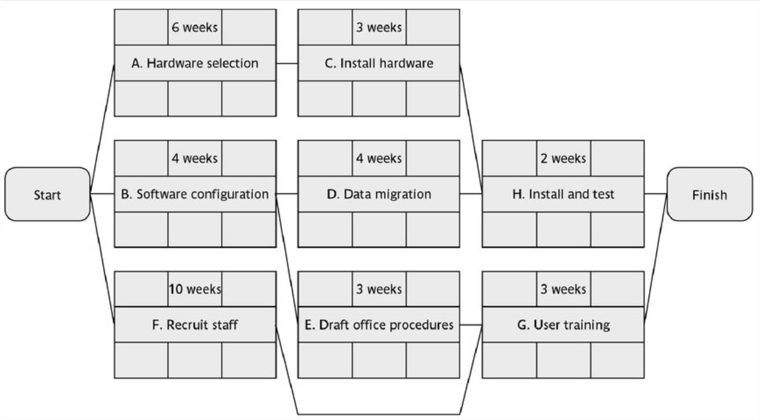
Example of an activity network
Notes:
Topics covered
Professional software development
What is meant by software engineering.
Software engineering ethics
A brief introduction to ethical issues that affect software engineering.
Suggested student projects
A brief introduction to each suggested project that can be carried out by students for this course

Slide 21
Complete the table
Activity | ES | duration | EF
A
B
C
D
E
F
G
H
Notes:
Topics covered
Professional software development
What is meant by software engineering.
Software engineering ethics
A brief introduction to ethical issues that affect software engineering.
Suggested student projects
A brief introduction to each suggested project that can be carried out by students for this course

Slide 22
Backward pass
Start from the last activity
Latest finish (LF) for last activity = earliest finish (EF)
work backwards
Latest finish for current activity = Latest start for the following
More than one following activity - take the earliest LS
Latest start (LS) = LF for activity - duration
Notes:
Topics covered
Professional software development
What is meant by software engineering.
Software engineering ethics
A brief introduction to ethical issues that affect software engineering.
Suggested student projects
A brief introduction to each suggested project that can be carried out by students for this course

Slide 23
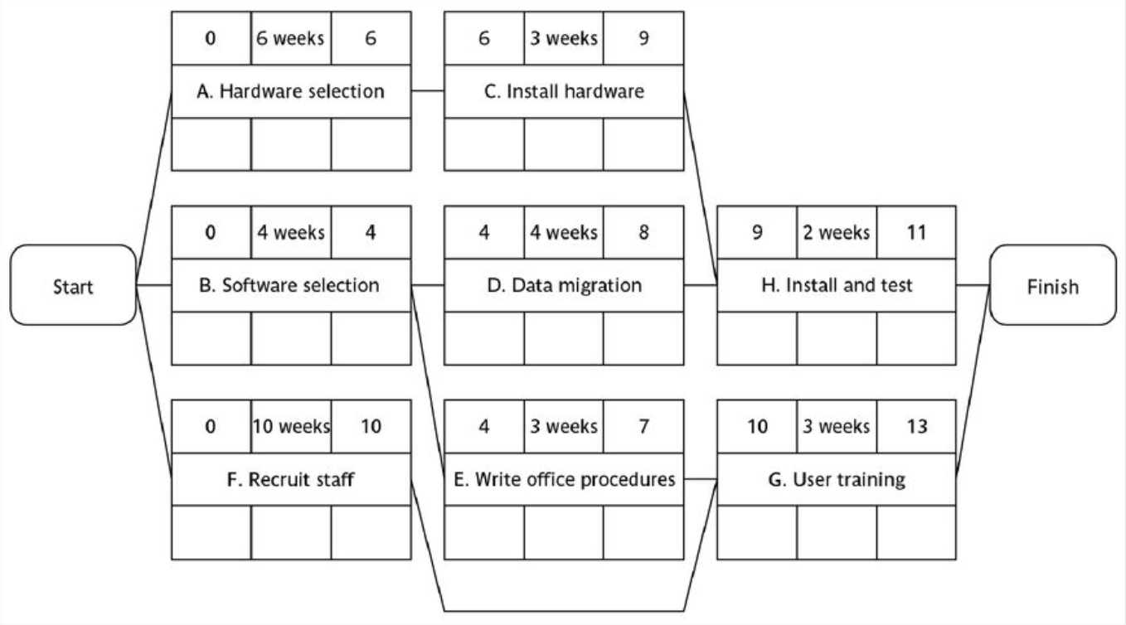
Example: LS for all activities?
Notes:
Topics covered
Professional software development
What is meant by software engineering.
Software engineering ethics
A brief introduction to ethical issues that affect software engineering.
Suggested student projects
A brief introduction to each suggested project that can be carried out by students for this course

Slide 24
Complete the table
Activity | ES | DUR | EF | LS | LF
A
B
C
D
E
F
G
H
Notes:
Topics covered
Professional software development
What is meant by software engineering.
Software engineering ethics
A brief introduction to ethical issues that affect software engineering.
Suggested student projects
A brief introduction to each suggested project that can be carried out by students for this course

Slide 25
Float
Float = Latest finish –
Earliest start –
Duration
ES
LF
activity
Latest start
Earliest finish
Notes:
Topics covered
Professional software development
What is meant by software engineering.
Software engineering ethics
A brief introduction to ethical issues that affect software engineering.
Suggested student projects
A brief introduction to each suggested project that can be carried out by students for this course

Slide 26
Complete the table
Act-ivity | ES | DUR | EF | LS | LF | Float
A
B
C
D
E
F
G
Notes:
Topics covered
Professional software development
What is meant by software engineering.
Software engineering ethics
A brief introduction to ethical issues that affect software engineering.
Suggested student projects
A brief introduction to each suggested project that can be carried out by students for this course

Slide 27
Critical path
Note the path through network with zero floats
Critical path: any delay in an activity on this path will delay whole project
Can there be more than one critical path?
Can there be no critical path?
Sub-critical paths
Notes:
Topics covered
Professional software development
What is meant by software engineering.
Software engineering ethics
A brief introduction to ethical issues that affect software engineering.
Suggested student projects
A brief introduction to each suggested project that can be carried out by students for this course

Slide 28
Free and interfering float
0 | 7W | 7
A
2 | 2 | 9
B can be up to 3 days late
and not affect any
other activity = free float
0 | 4W | 4
B
5 | 5 | 9
7 | 1W | 8
D
9 | 2 | 10
10 | 2W | 12
E
10 | 0 | 12
0 | 10W | 10
A
0 | 0 | 10
B can be a further 2 days late – affects
D but not the project end date =
interfering float
Notes:
Topics covered
Professional software development
What is meant by software engineering.
Software engineering ethics
A brief introduction to ethical issues that affect software engineering.
Suggested student projects
A brief introduction to each suggested project that can be carried out by students for this course

